Slide 1

Analysis 1: Foundations of Modeling Lessons 3.1: Boolean logic
Analysis Team, 2020/2021

Slide 2
Overview of this lesson: Boolean logic
Introduction to logic,
Statements and propositions,
Boolean logic,
Operators in Boolean logic,
Fundamental operators,
Derived operators,
Implication operators.

Slide 3
Overview of this lesson: Boolean logic
Learning objectives:
Get acquainted with logic and Boolean logic, terms and definitions,
Learn Boolean logic operators
Evaluate Boolean expressions using truth tables
At the end of the lesson a student should be able to:
Model a problem using Boolean notation
Use Boolean logic operators and truth tables to solve a problem

Slide 4
Introduction to Logic
Definition, Statements, propositions

Slide 5
Introduction to Logic
Logic is the study of the criteria used in evaluating inferences or arguments. The name comes from the Greek "logos", - thought, idea, argument, account, reason or principle.
An inference is a process of reasoning in which a new belief is formed on the basis of or in virtue of evidence or proof supposedly provided by other beliefs.
An argument is a collection of statements or propositions, some of which are intended to provide support or evidence in favor of one of the others.

Slide 6


Statements
Definition: Statements are the kind of sentences that are either TRUE or FALSE.
A statement is an assertion that something is or is not the case. A statement is true if what it asserts is the case, and it is false if what it asserts is not the case.
The Eiffel Tower is 324 meters high. This statement is TRUE.
Mount Everest is 324 meters high. This statement is FALSE.
Source: Patrick Girard, University of Auckland

Slide 7
Statements
Statements
Non-statements
The trains are always late.
Drunk driving is the top cause of car accidents.
I like oranges because they have no bones.
The sun rises in the East.
1 + 1 = 2
‘A’ is the first alphabet letter.
Welcome to Rotterdam.
How can I stop drinking?
When you play “top” in League of Legends, make sure you always take “tanky” character.
What time is it?
Oranges taste good.
Sentences that do not have a truth value are non-statements.
Notes:
Note: “Oranges taste good” is an opinion and as such doesn’t have a truth value.

Slide 8
Statements vs. Propositions (optional)
Some authors go into more details and distinguish between statements and propositions. According to this approach:
Statements are used to EXPRESS propositions.
Propositions, unlike statements, are NOT linguistic objects.
They (propositions) are objects that can have truth value.
Key idea: Statements EXPRESS propositions, which are then said to be TRUE or FALSE.
For example: “The snow is white” is a statement that itself doesn't have a truth-value, but instead expresses the proposition that snow is white. Since snow is white, this proposition is TRUE.
Source: Leitgeb, Hartmann (2014) Introduction to Mathematical Philosophy
Notes:
Note: this slide can be used by students in the future if they need to know the difference between statements and propositions. Not required for Analysis courses.

Slide 9
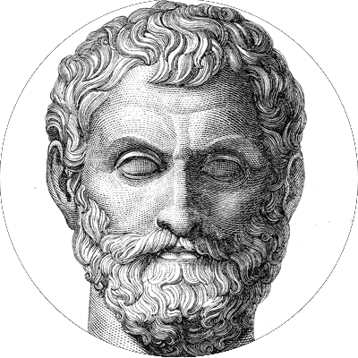
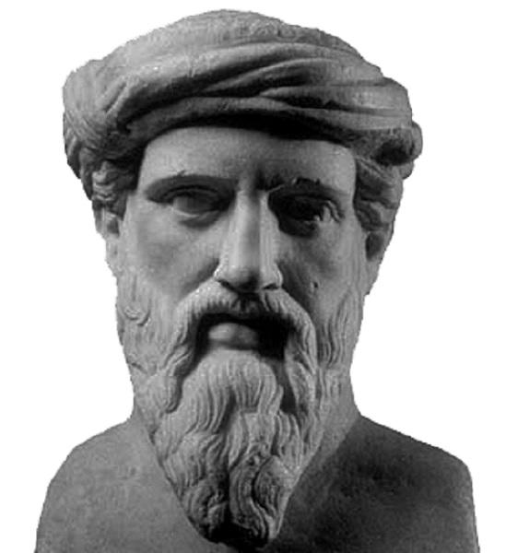
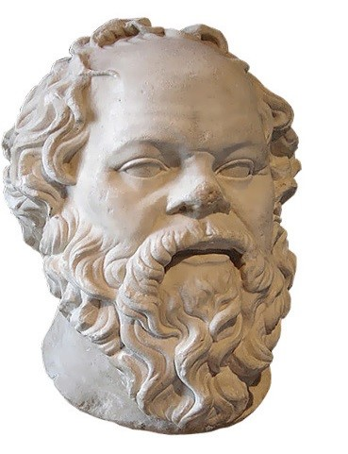
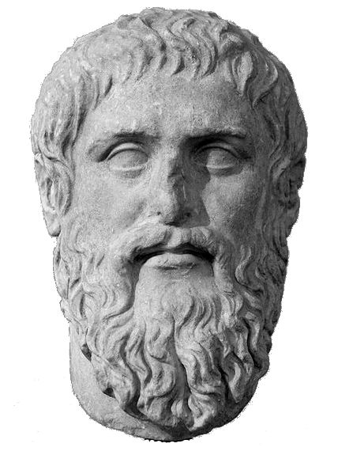
A brief history of Logic (optional)
The earliest recorded forms of deductive reasoning by ancient Greek philosophers (mathematicians, astronomers).
Thales of Miletus
(625 – 545 BC)
Pythagoras
(570 – 497 BC)
Socrates
(469 – 399 BC)
Plato
(428 – 347 BC)

Slide 10
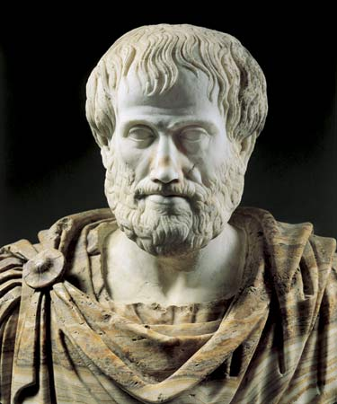
A brief history of Logic (optional)
Aristotle (384 – 322 BC)
Ancient Greek philosopher.
“Father” of Logic as science.
Author of ORGANON.
= instrument / tool
Systematization of logical knowledge.
Logic should be the “tool” used by other sciences.

Slide 11
A brief history of Logic (optional)
Syllogism teaching - logical argument that applies deductive reasoning to arrive at a conclusion based on two or more propositions that are asserted or assumed to be true.
Reasoning based on 3 statements; 2 premises and 1 conclusion.
Example:
All men are mortal.
Socrates is a man.
➔
Socrates is mortal.

Slide 12
Boolean Logic

Slide 13
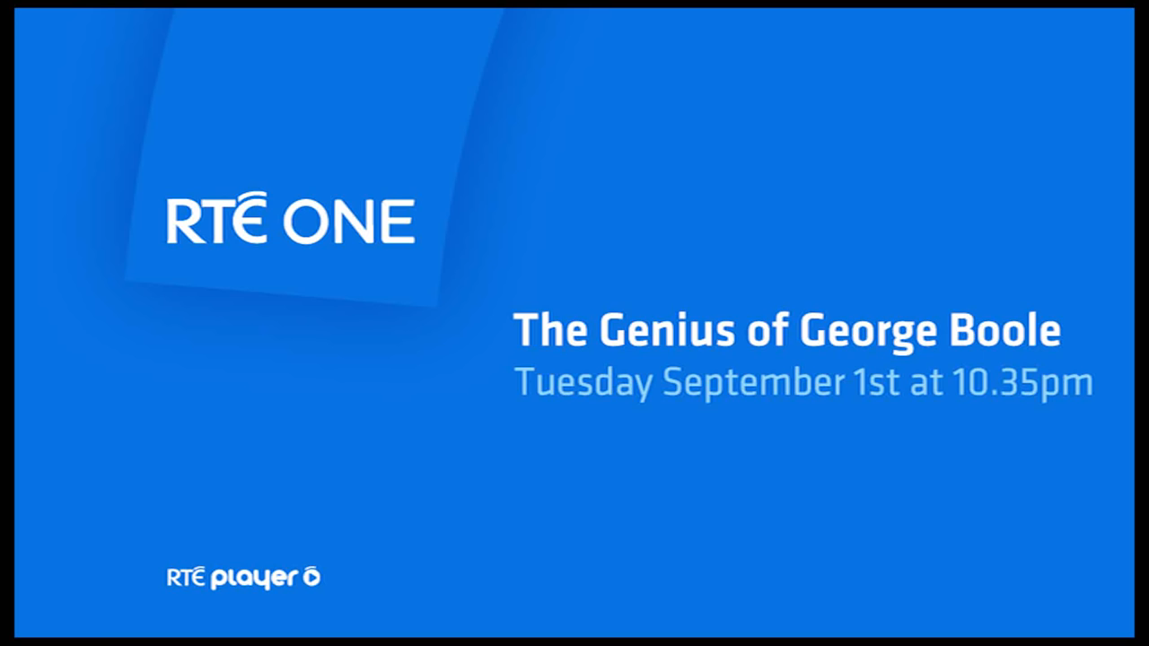
Introduction to George Boole
Notes:
Link to source video:
https://www.youtube.com/watch?v=aEjzjLv-YjI

Slide 14
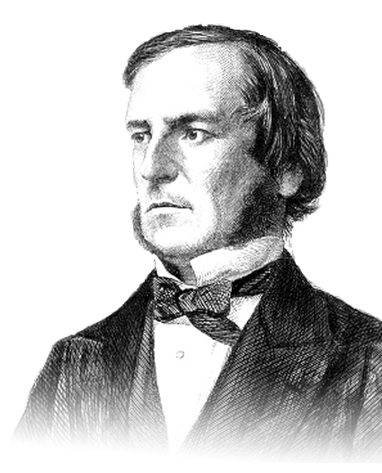
Introduction to George Boole
George Boole (1815 - 1864)
Self-taught English mathematician.
Wanted to represent logical statements that went beyond Aristotle’s approach to logic.
Mathematical algebra is all about numbers, and operators ( +, -, *, …) to be used with them.
Instead of using numbers, Bool went to apply mathematical laws to logical statements.

Slide 15
Introduction to George Boole
Boole’s approach allowed truth to be systematically and formally proven through logic equations.
First book – “The Mathematical Analysis of Logic”, 1847.
Initially his work didn’t bring him credit.
70 years later, Claude Shannon made a connection with Boolean Logic and a relay being ON and OFF.

Slide 16
Regular vs. Boolean algebra
Regular algebra
Boolean algebra
The values of variables are numbers.
Operations on those numbers are addition (+), multiplication (*), subtraction (-), …
The values of variables are TRUE and FALSE.
Operations on those values are logical operations:
3 fundamental: NOT, AND, OR
derived: NOR, XOR, IMPLICATION, EQUALITY, …

Slide 17
Propositional logic = Boolean logic
The area of logic which deals with propositions is called propositional calculus or propositional logic.
It also includes producing new propositions using existing ones.
Propositions constructed using one or more propositions are called compound propositions.
The propositions are combined together using Logical Connectives or Logical Operators.

Slide 18
Boolean logic – main idea
Start off with the idea that some statement P is either TRUE or FALSE.
The beauty of Boolean logic is that a statement can’t be anything in between.
Then, form other statements, which are TRUE or FALSE …
… by combining initial statement(s) with fundamental operators: NOT, AND, OR.

Slide 19
Operators in Boolean Logic

Slide 20
Fundamental Boolean operators
There are three fundamental Boolean operators:
NOT (symbolically ~ or ¬) - negation
AND (symbolically: ∧) - logical conjunction
OR (symbolically: ∨) - alternation / disjunction
Boolean logic has unary operators (simplest operators applied to only single TRUE or FALSE value) like Identity, logical True and logical False; but they are of no interest for this course and will be disregarded from now on.

Slide 21
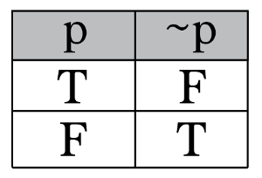
NOT - negation
NOT takes a single Boolean value and negates it (flip).
The negation operator is commonly represented by a tilde (~) or (¬) symbol.
It negates, or switches, something’s truth value.
This relationship can be shown in a TRUTH TABLE → a way of organizing information to list out all possible scenarios.
Notes:
Therefore, if P = TRUE, then not(P) = not(TRUE) = FALSE
If P = FALSE, then not(P) = not(FALSE) = TRUE

Slide 22
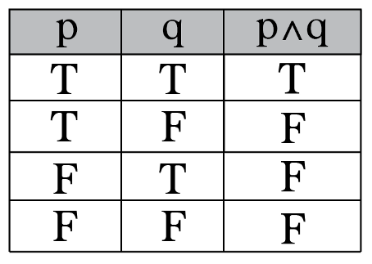
AND – logical conjunction
AND is a binary operator, which means it will take two Boolean values (p and q) and return one.
The AND operator returns TRUE only if both propositions p and q are TRUE.
Every other case will return FALSE.
The AND operator is symbolically represented as : ∧.
Notes:
If p = TRUE AND q = TRUE, then p ∧ q = TRUE
If p = TRUE AND q = FALSE, then p ∧ q = FALSE
If p = FALSE AND q = TRUE, then p ∧ q = FALSE
If p = FALSE AND q = FALSE, then p ∧ q = FALSE

Slide 23
AND – logical conjunction
You can think of AND like a lie detector. You are honest if you don’t lie at all. If you lie “just a bit”, regardless on which question, you are essentially not honest.
Example:
My name is Andrej AND I wear glasses.
p
q
TRUE
∧
TRUE
= TRUE
Notes:
If p = TRUE AND q = TRUE, then p ∧ q = TRUE
If p = TRUE AND q = FALSE, then p ∧ q = FALSE
If p = FALSE AND q = TRUE, then p ∧ q = FALSE
If p = FALSE AND q = FALSE, then p ∧ q = FALSE

Slide 24
AND – logical conjunction
p
q
Example:
My name is Marry AND I wear glasses.
My name is Andrej AND I wear a hat.
My name is Marry AND I wear a hat.
FALSE
∧
TRUE
= FALSE
TRUE
∧
FALSE
= FALSE
FALSE
∧
FALSE
= FALSE
Notes:
If p = TRUE AND q = TRUE, then p ∧ q = TRUE
If p = TRUE AND q = FALSE, then p ∧ q = FALSE
If p = FALSE AND q = TRUE, then p ∧ q = FALSE
If p = FALSE AND q = FALSE, then p ∧ q = FALSE

Slide 25
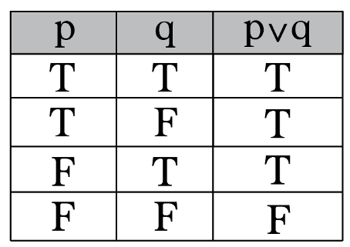
OR – alternation / disjunction
OR is also binary operator, which means it will take two Boolean values (p and q) and return one.
The OR operator requires only one premise p or q to be TRUE to return TRUE.
Both premises must be FALSE for OR to return FALSE.
The OR operator is symbolically represented as : ∨.
Notes:
If p = TRUE, q = TRUE, then p ∨ q = TRUE
If p = TRUE, q = FALSE, then p ∨ q = TRUE
If p = FALSE, q = TRUE, then p ∨ q = TRUE
If p = FALSE, q = FALSE, then p ∨ q = FALSE

Slide 26


OR – alternation / disjunction
Example:
I am drinking coffee OR I am drinking tea.
This is TRUE as long as I am served either tea, coffee, or both.
Only if I get neither, this is FALSE.
= TRUE
= FALSE
Notes:
If p = TRUE, q = TRUE, then p ∨ q = TRUE
If p = TRUE, q = FALSE, then p ∨ q = TRUE
If p = FALSE, q = TRUE, then p ∨ q = TRUE
If p = FALSE, q = FALSE, then p ∨ q = FALSE

Slide 27


OR – alternation / disjunction
Example (continued):
This means you can make interesting statements:
I am Ronaldo OR I wear glasses.
Regardless if you are Ronaldo or not, as long as you wear glasses, the above statements will evaluate to be true. ☺

Slide 28
Other Boolean operators
Using fundamental Boolean operators others can be constructed:
NOR (symbolically ↓) - logical NOR
XOR (symbolically: ⊕, ⊻) - exclusive OR

Slide 29
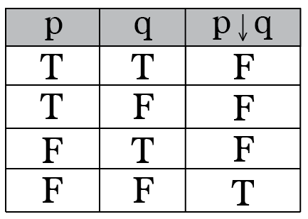
NOR
Logical NOR is the exact opposite of OR.
It requires both p and q to be FALSE to result in TRUE.
The NOR operator is symbolically represented as : ↓.

Slide 30
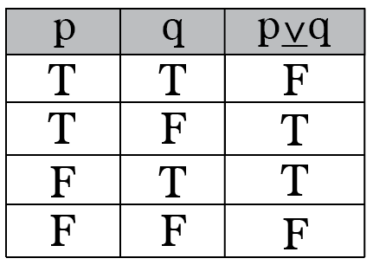
XOR - exclusive OR
Exclusive OR - XOR short.
It requires exactly one TRUE and one FALSE value in order to result in TRUE.
The XOR operator is symbolically represented as : ⊕ (sometimes ⊻).

Slide 31
Implication operators
Two implication operators:
IMPLICATION (symbolically →) - logical implication; a.k.a. “if-then”
EQUALITY (symbolically: ↔) - biconditional / double implication
The first one (IMPLICATION, →) can be read as: if P then Q.
The second one (BICONDITIONAL, ↔) can be read as:
if and only if P then Q.

Slide 32
IMPLICATION
Known as “IF … THEN …”
Boolean implication P implies Q ( P → Q ) means:
If P is true, then Q MUST be true.
Consequently, this implies that:
If P isn’t true, then Q can be ANYTHING.
The IMPLICATION operator is symbolically represented as : →.
This is the only operator students find daunting on the first glance.

Slide 33
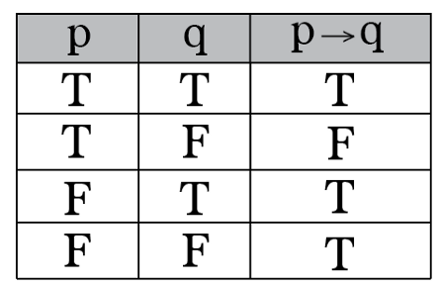
IMPLICATION
Let’s take a look at implication p → q truth table. It is FALSE only when TRUE → FALSE. In every other case it is TRUE.
We can call this reasoning “innocent until proven guilty”, which means the implication p → q is considered TRUE until proven FALSE.
Alternatively we have: “a FALSE statement implies ANYTHING”.

Slide 34
IMPLICATION
For clarity, we illustrate → with an example.
If your pet is a dog, then your pet is a mammal.
Your pet is a dog.
Your pet is a cat.
Your pet is a fish.
Can you think of an example where P → Q is false when P = is dog (true)?
p (is dog) | q (is mammal)
TRUE | TRUE
FALSE | TRUE
FALSE | FALSE
It doesn’t exist!

Slide 35
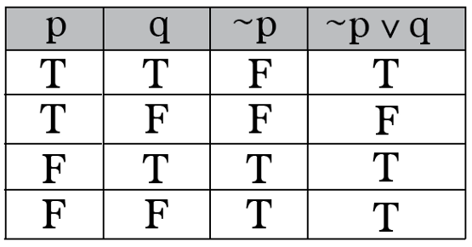
IMPLICATION
Alternatively, as the implication p → q is logically equivalent to ¬p ∨ q, we can derive the same result using the following truth table:
p → q
¬p ∨ q
ATTENTION! ¬p ∨ q ≠ ¬(p ∨ q)

Slide 36
EQUALITY - biconditional, double implication, equivalence
Logical equality is also known as biconditional or double implication.
Known as “IF and only if … THEN …”
The EQUALITY operator is symbolically represented as : ↔.
Logical equality is the conjunction: (p → q) ∧ (q → p).
Equality is if-then statement where the converse is also true.

Slide 37
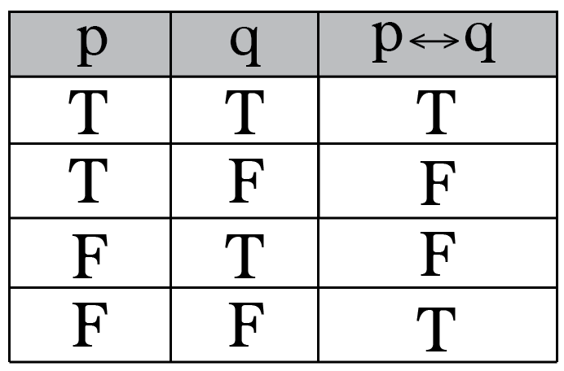
EQUALITY - biconditional, double implication
The implication is true when p and q have the same truth values; it is false otherwise.

Slide 38
Exercises

Slide 39
Exercise 1 – doorbell
Assume you are living in a house that has two doors, front and back, each with a button to ring a bell. You have a sensor connected to each button that detects two states: 1 (true) – button pressed; 0 (false) – button not pressed.
You connected these buttons to the single bell in the house and you want the bell to ring when someone presses the button either at the front or at the rear door.
Which logical variables and operators would you use to build doorbell system?
Write Boolean equation and prove it with truth table.

Slide 40
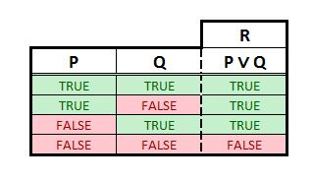
Exercise 1 – door bell (solution)
P – button 1 (front door) pressed
Q – button 2 (rear door) pressed
R – bell ringing
P ∨ Q ↔ R

Slide 41
Exercise 2 – alarm system
You are building your home alarm system. This system is connected to two sensors. The first is the light sensor, that distinguishes between day and night (TRUE – day, FALSE – night). The second is connected to the window and has the following values: TRUE – window open, FALSE – window closed.
Assume that you want to open windows during the day.
You can treat the burglary in progress as a case when the window is opened during the night.
Which logical variables and operators would you use to build your alarm system?
Write Boolean equation and prove it with truth table.

Slide 42
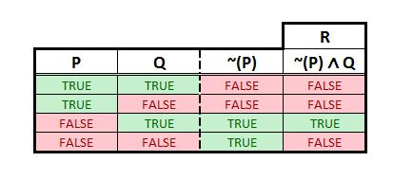
Exercise 2 – alarm system (solution)
P – daytime
Q – window open
R – burglary in progress
~P ∧ Q ↔ R

Slide 43
Summary Quiz
What is logic?
What is an inference?
What is an argument?
What are (logical) statements?
What are non-statements?
What is the main idea behind Boolean algebra and what is its significance?
What values can Boolean variables take?
What are fundamental Boolean operations?

Slide 44
Summary Quiz
What is logical negation?
What is logical conjunction?
What is logical disjunction?
What is logical implication?
What is logical equality / biconditional implication?

Slide 45
Summary
Logic is the study of the criteria used in evaluating inferences or arguments.
An inference is a process of reasoning in which a new belief is formed on the basis of or in virtue of evidence or proof supposedly provided by other beliefs.
An argument is a collection of statements or propositions, some of which are intended to provide support or evidence in favor of one of the others.
Statements are the kind of sentences that are either true or false.
Sentences that do not have a truth value are non-statements.
In contrast to mathematical algebra (dealing with numbers), the focus of Boolan algebra is on applying mathematical laws to logical statements. Boole’s approach allowed truth to be systematically and formally proven through logic equations.
The values of Boolean variables are TRUE and FALSE.
There are three fundamental Boolean operators: negation - NOT (~ or ¬), conjunction - AND (∧), disjunction - OR (∨).

Slide 46
Summary
NOT is a unary operator that takes a single Boolean value and negates it.
AND is a binary operator, which returns TRUE only if both propositions p and q are TRUE. Otherwise, AND (conjunction) returns FALSE.
OR is a binary operator that requires only one premise p or q to be TRUE to return TRUE. Both premises must be FALSE for OR (disjunction) to return FALSE.
Implication (also known as logical consequence, implies, or If ... then) is the relationship between statements that holds true when one logically "follows from" one or more others. Implications returns false if and only if the first term is true and the second term is false. From a false proposition, anything can follow.
Logical equality or biconditional implication is the relationship between logical propositions that are either both true or both false, so that the affirmation of one and the denial of the other results in contradiction. Therefore, biconditional implication is true if both propositions are either true or false, otherwise, it is false.

Slide 47
Extra material - videos
Disclaimer:
The following videos are not part of the course material, and as such, are treated as an extra information. The teaching team believes it is beneficial to the students to also have the topics presented from a different perspective. Some video will provide more information that given at the lesson, some less.
For the exam, the only relevant information is considered the one given by the teachers and written in the course book.
To understand the topics better, using external sources, like the videos given below, is strongly recommended. Feel free to explore, and ask your teacher should you have any questions.

Slide 48
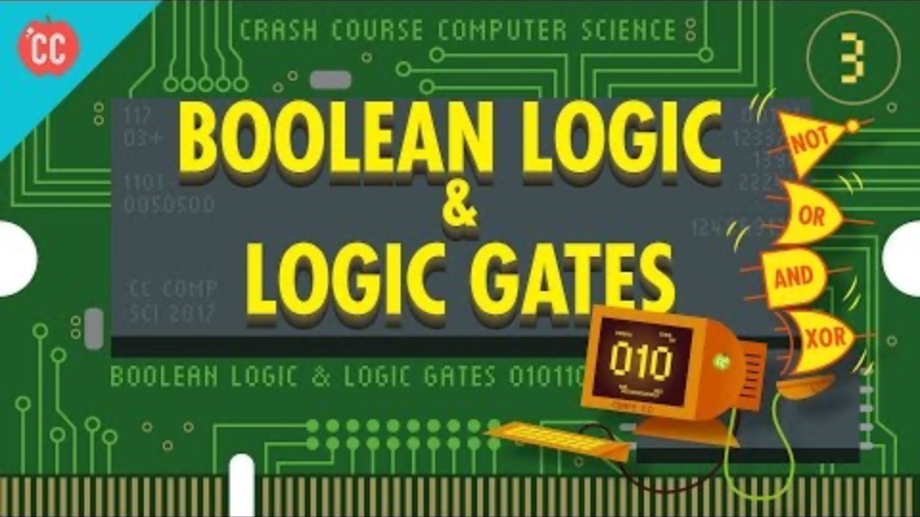
Boolean logic and logic gates
Notes:
URL:
https://www.youtube.com/watch?v=gI-qXk7XojA

Slide 49
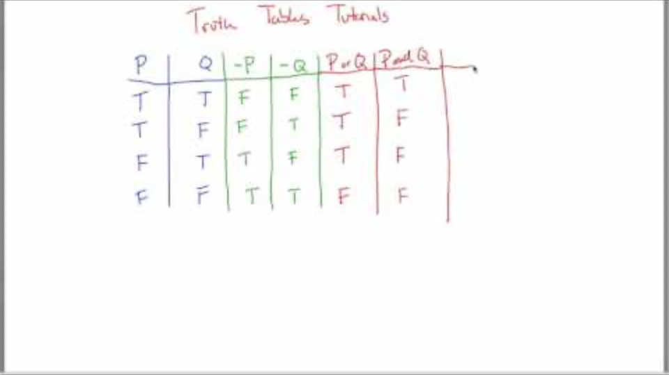
Truth tables
Notes:
URL:
https://www.youtube.com/watch?v=VCEYeB3bRW0

Slide 50
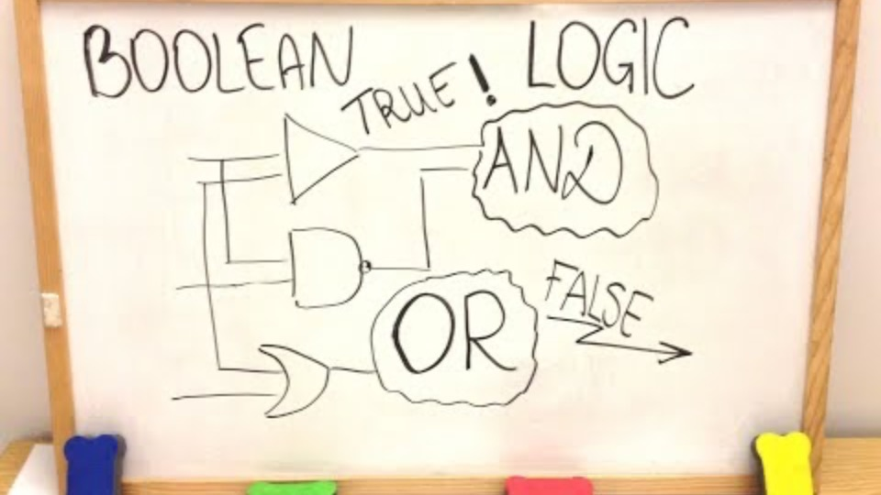
Boolean algebra and logic practice
Notes:
URL:
https://www.youtube.com/watch?v=Hby4mlpSNxo

Slide 51
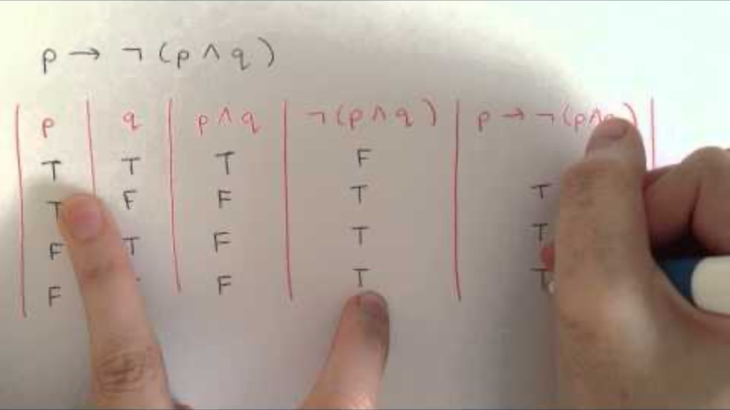
More practice with truth tables
Notes:
URL:
https://www.youtube.com/watch?v=wRMC-ttjhwM

Slide 52
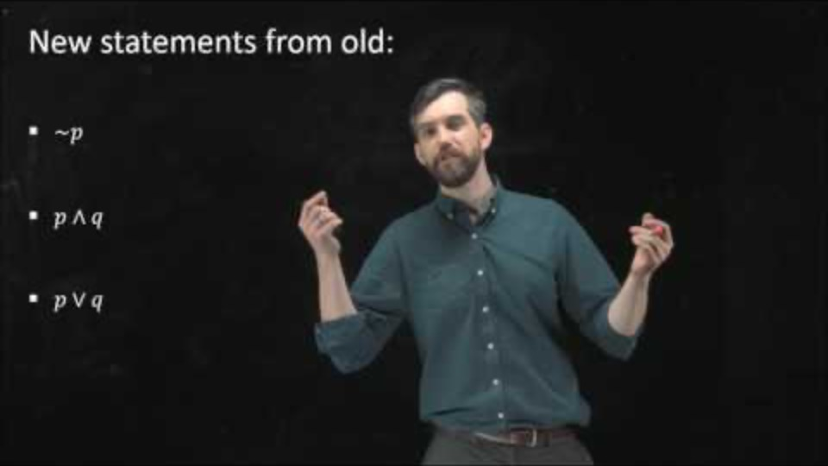
1 / 5 – Intro to logical statements
Notes:
URL:
https://www.youtube.com/watch?v=q2eyZZK-Oik

Slide 53
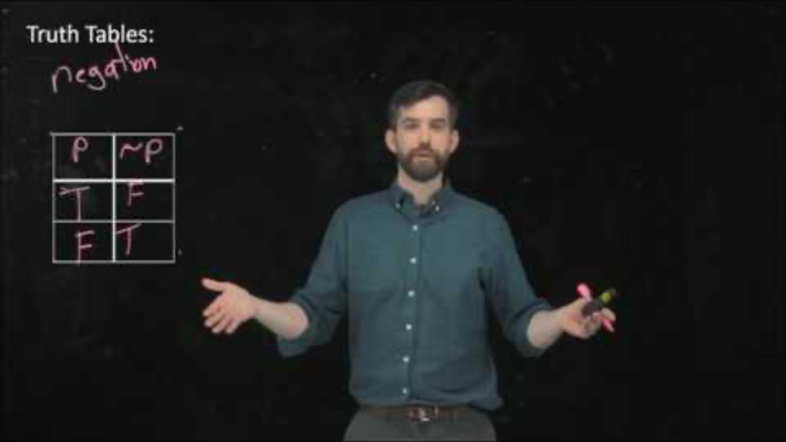
2 / 5 – Negation, conjunction, disjunction (not, and, or)
Notes:
URL:
https://www.youtube.com/watch?v=7mulE-zramc

Slide 54
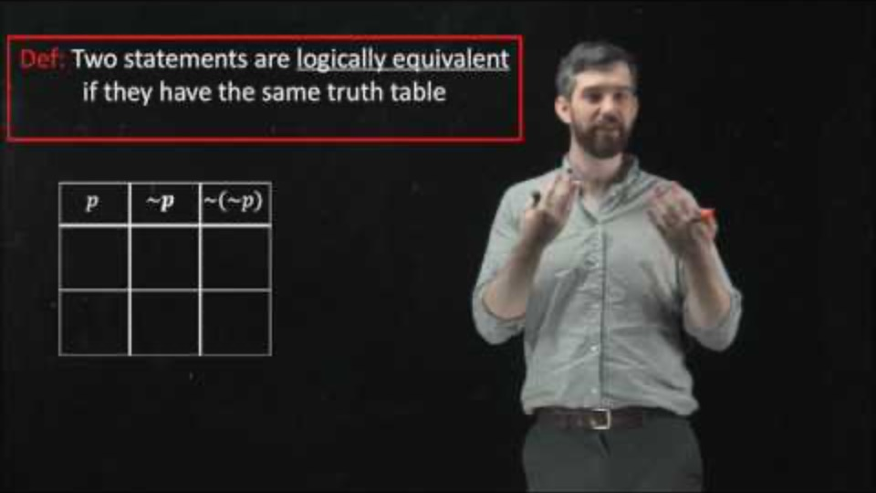
3 / 5 - Logial equivalence
Notes:
URL:
https://www.youtube.com/watch?v=U2zPxuj8mnI

Slide 55
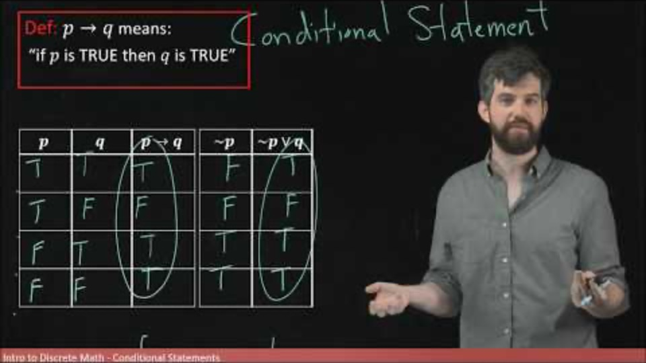
4 / 5 - Conditional statements
Notes:
URL:
https://www.youtube.com/watch?v=F3544ZyO-eU

Slide 56
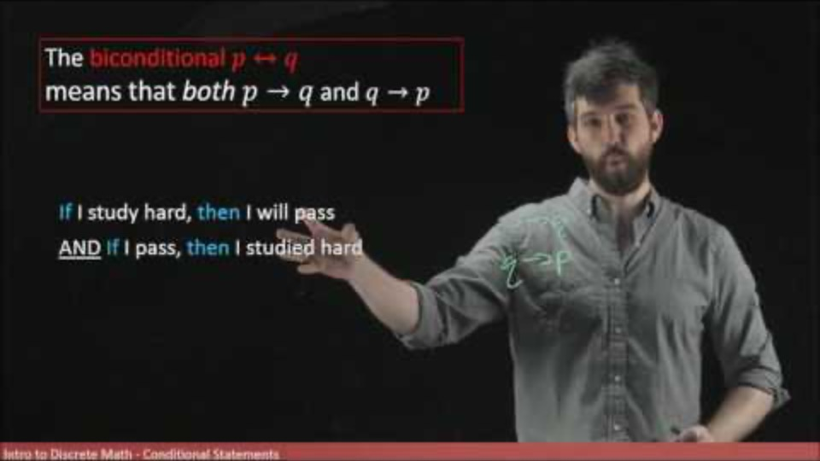
5 / 5 - Biconditional statements
Notes:
URL:
https://www.youtube.com/watch?v=oHijygNdx_8

Slide 57
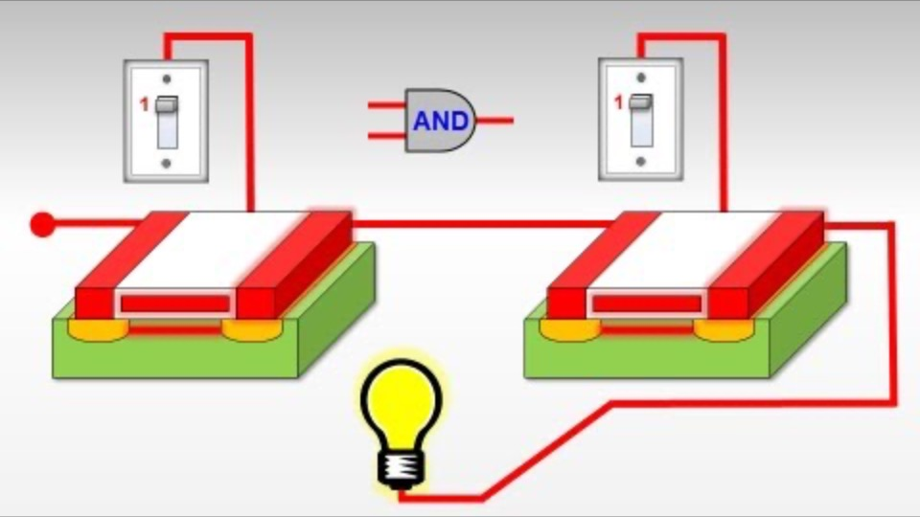
How computers add numbers
Notes:
URL:
https://www.youtube.com/watch?v=VBDoT8o4q00

